Slide 1
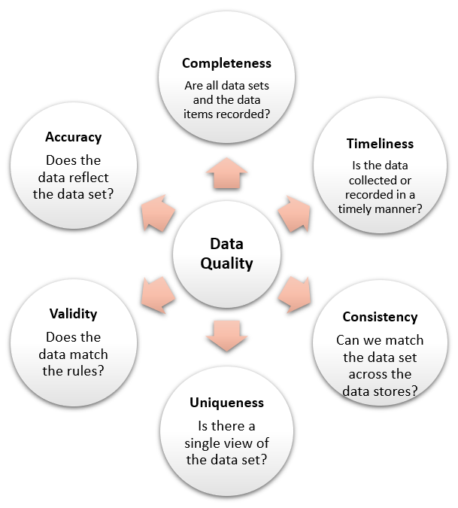
Data Quality Dimensions
Data Quality Rules:
Requirements->code-> implement
Data Quality Techniques:
data wrangling, data profiling, …
Data Quality process
Data Quality Tools :
BM, SAP, Oracle, Informatica, Talend, Precisely, Ataccame
Data quality best practices
https://www.dataversity.net/data-quality-dimensions/
Image from https://healthinstitute.illinois.edu/connect/news/berd-tips-dimensions-of-data-quality
Notes:
Profiling (Statistics of Data)
Parsing (from non-structured data to structured data)
Standardization : common format for all data
Identity resolution( which two records are the same?)
Data Linkage : linking and merging records
Data cleansing
Data enhancement
Data inspection and monitoring: data quality metrics

